Slide 1
WANTED!
ALISIA ZARBO – ENRICA ZANI
DHDK master degree
a.a. 2020-21
Alive or alive
92986 - Digital Heritage and Multimedia
92985 - Interaction Media Design
85453 - Museology, Museography and Virtual Environments

Slide 2
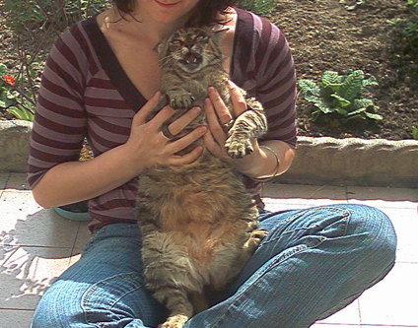
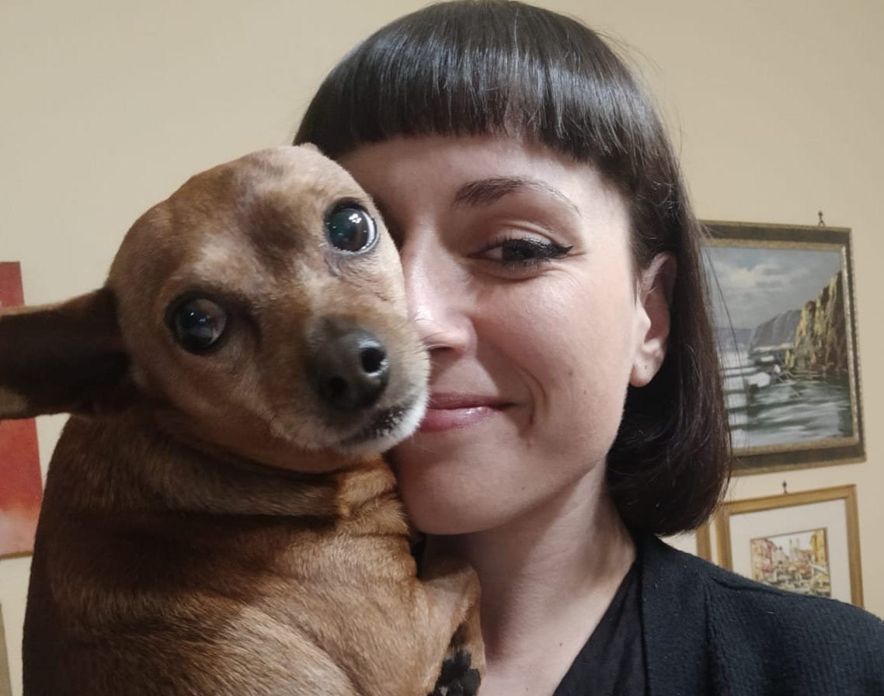
Team roles
Alisia Zarbo and Billy
Ideation cards museological approach; social media analysis; Personas; Scenarios with Twine; Virtual Frida's room with Blender; feasibility plan
Enrica Zani and Bigio
Basic idea and preliminary data section; physical museum analysis; Virtual Exibhition building with Omeka; application interaction diagram with Twine; mercandising ideation; privacy and copyright issues; bibliography

Slide 3
WANTED!
Team roles
Intro
The website (prototype)
In Art – The Exhibit
3d Frida room
Choose your Guide! I.A.
Share your story
Merchandising
Forthcoming app
Preliminary data and Inspiration
Ideation process
Preliminary brainstorming and data analysis
Benchmark on reference institutions
Ideation cards and disruptive design
PACT FRAMEWORK
SCENARIOS
Cognitive focus
Museological approach
RECAP
Notes:
ugly duckling

Slide 4
WANTED! Alive or alive
Wanted! is a project that have been inspired by a corpus of lost-pets-advertisements photographs, collected by the authors over the years in various places.
It is focused on the complex relationship between humans and their pets in an anti-speciesism view of interpersonal relationship and family binds.
The name Wanted! comes from the strong visual relationship of these SOS-flyers with the Old West bandit bans even if, like the subtitle “Alive or Alive” explains, with different and opposite purposes and intents.
Notes:
ugly duckling

Slide 5
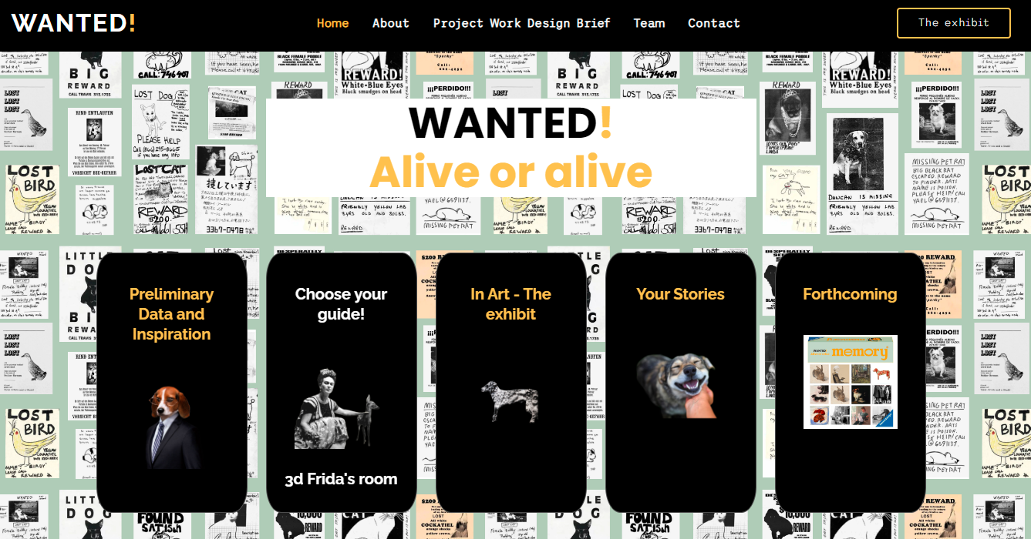
WANTED!
MI-FI PROTOTYPE
a growing souvenir-book built from users’ stories in the Your Stories section;
The website
The website https://enri-ca.github.io/WANTED/, is conceived as a multi-dimensional cultural environment offering different paths to be explored:
a Preliminary Data and Inspiration section to access data – such as the already mentioned corpus of lost-pets-advertisements photographs - analysed to realize the project;
a current virtual exhibition and its related interactive applications in the In Art – The Exhibit and Choose your guide and 3d Frida's room sections;
a preview of the developments in the Forthcoming section
Notes:
ugly duckling

Slide 6
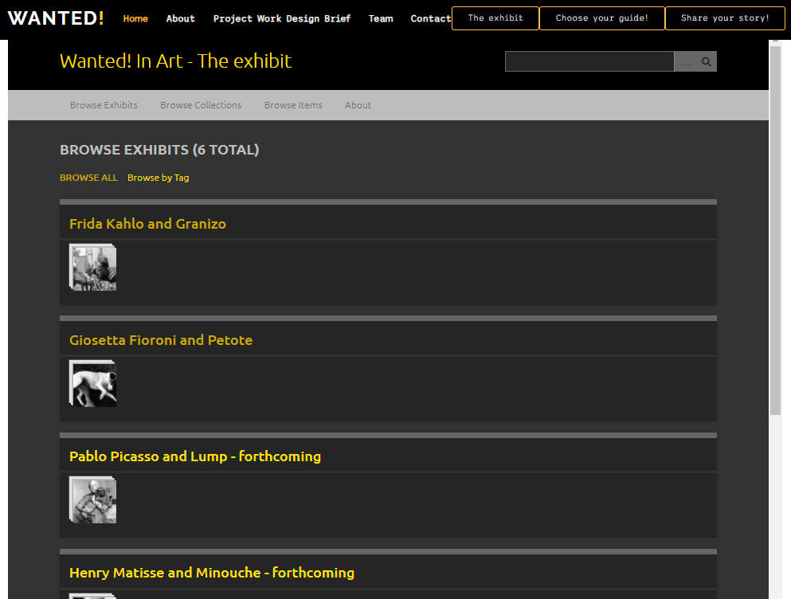
In Art – The exhibit
MI-FI PROTOTYPE
Virtual Exhibition
A virtual exhibition on the relationship of some artists and their pets:
6 artist’s paths:
Frida Kahlo and Granizo, Giosetta Fioroni and Petote (realized);
Pablo Picasso and Lump, Henry Matisse and Minouche, Salvador Dalí and Babou (forhcoming)
Tool: Omeka.net
Database of heterogeneous cultural objects, held by different institutions
DC description
Useful tool for museological paths
Notes:
ugly duckling

Slide 7
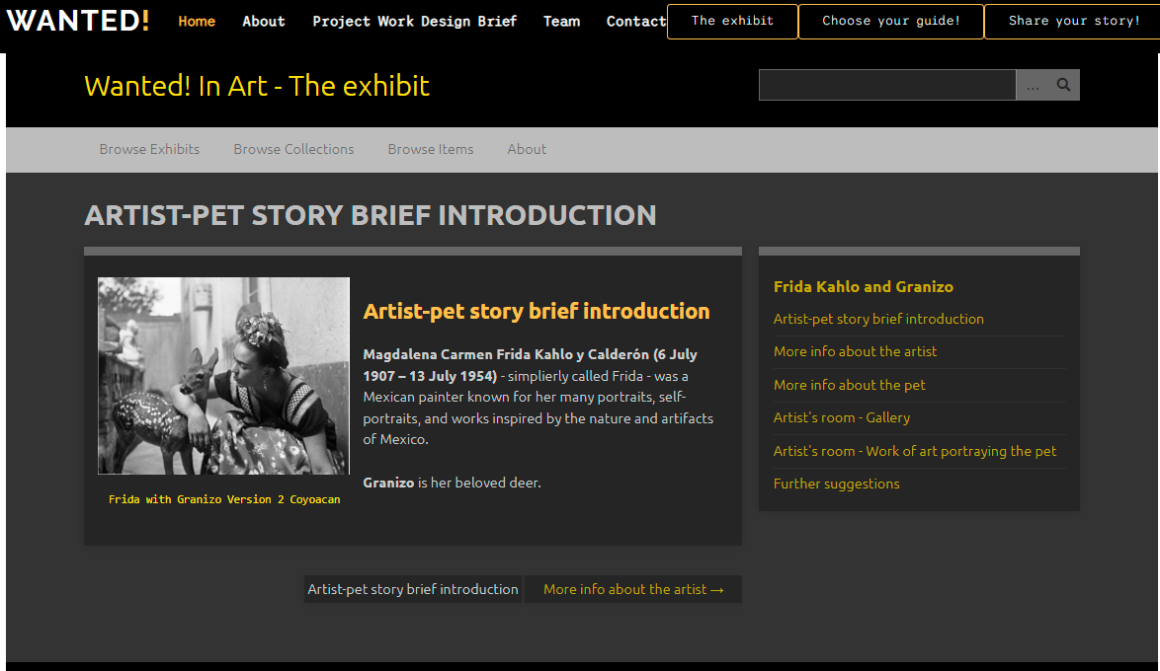
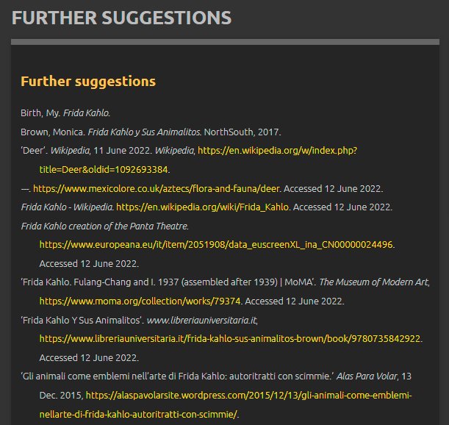
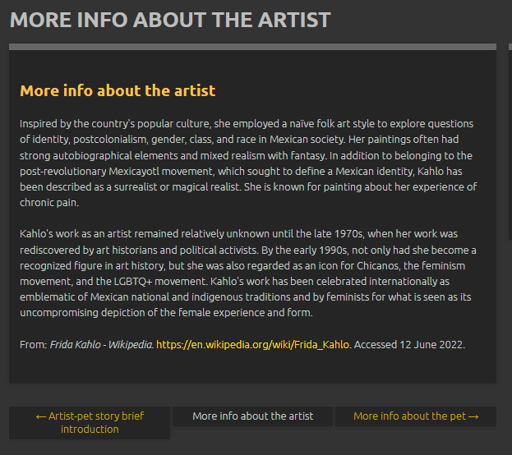
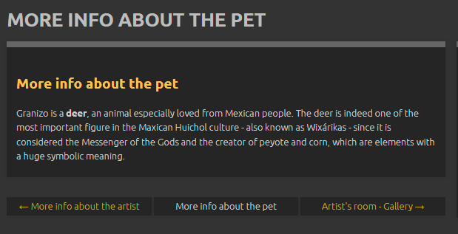
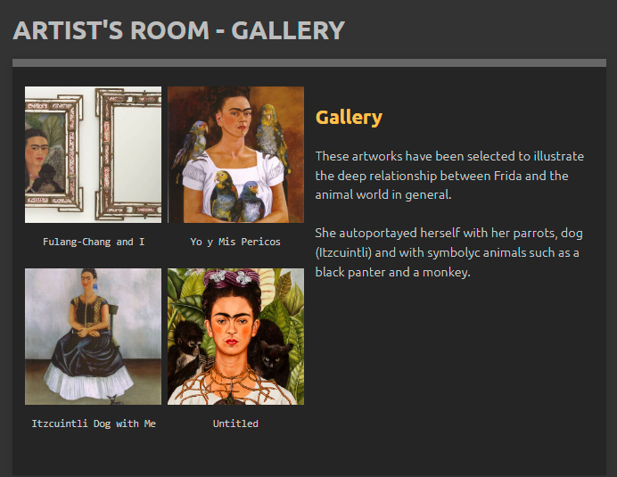
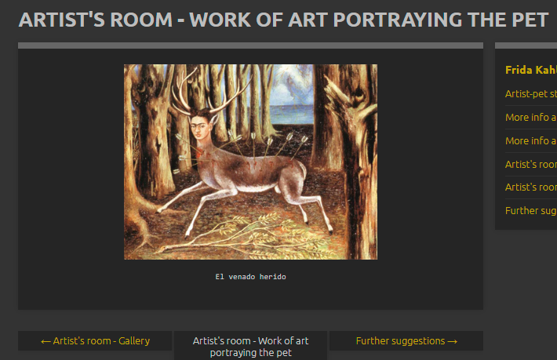
In Art – The exhibit
MI-FI PROTOTYPE
Virtual Exhibition
Notes:
ugly duckling

Slide 8
In Art – The exhibit
MI-FI PROTOTYPE
Virtual Exhibition
To be developed:
Use of original digital version of images in IIIF protocol
Use of original metadata of cultural objects with OAI-PMH
Creation of RDF data structure and Knowledge graph visualization and surfing
Exporting of VE content/structure from Omeka
Different texts/languages/paths for different target audiences
Notes:
ugly duckling

Slide 9
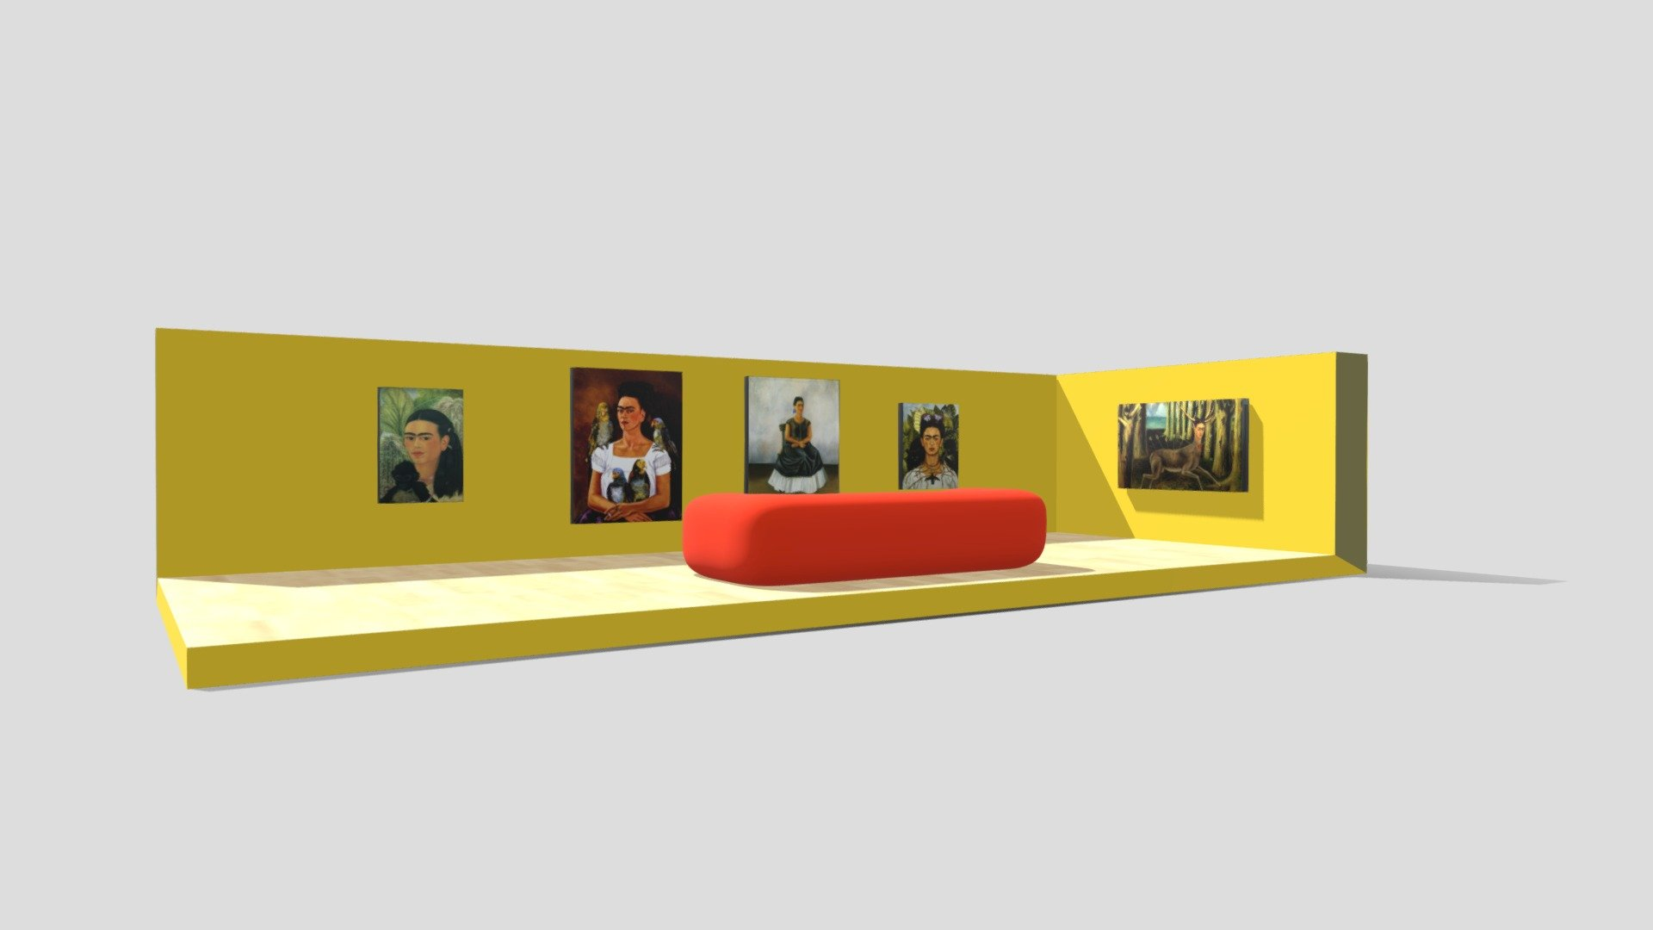
3d Frida’s room
MI-FI PROTOTYPE
Complementary material
INTERACTION
User capability of modifying the evironment and receiving a feedback from their actions, key element, togheter with
IMMERSIVITY
to realize presence – belief of actually being – in a
VIRTUAL SPACE
EXPERIENCE
Interactive computer graphic
3d animation/Rendering
Format file: *.Obj
Sw: Blender, Sketchfab
Notes:
(Carrozzino, Bergamasco 2010: 452-458)

Slide 10
3d Frida’s room
MI-FI PROTOTYPE
Complementary material
To be developed:
Complete all the rooms of the 3d museum model
Realize a total immersive 3D experience providing a format for gears. (This may create some changes in the definition of the target due to the tool used)
Make also the 3d guide (we will se it in a minute!) computer grafic interactive
Actual implementation of the option to use «your pet» as a guide
Notes:
ugly duckling

Slide 11
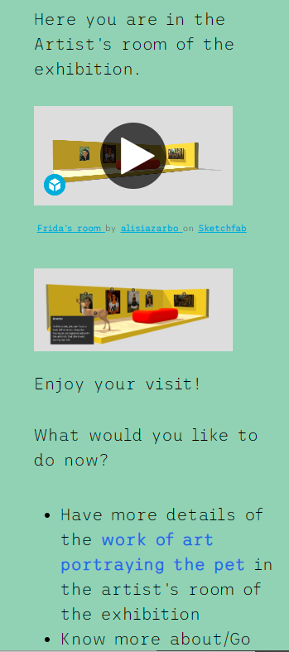
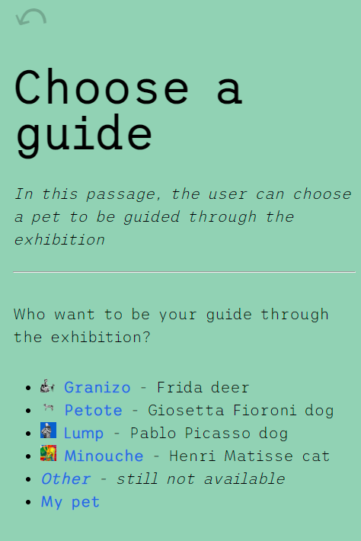
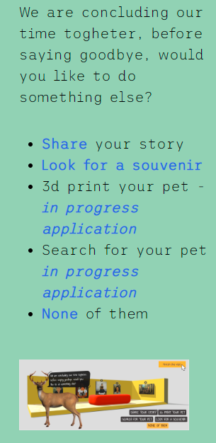
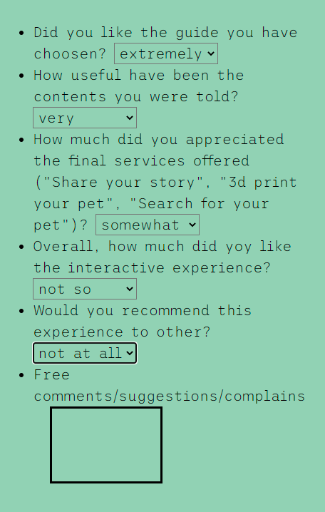
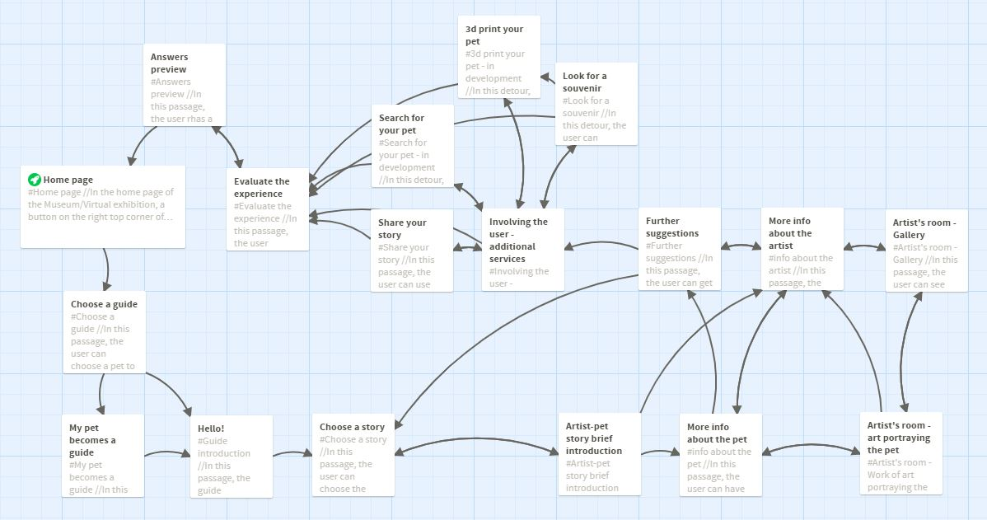
Choose your Guide!
Interactive application
CONCEPTUAL SCENARIO
NAVIGATION MAP
Likert scale
Extremely
Very
Somewhat
not so
not at all
Notes:
ugly duckling

Slide 12
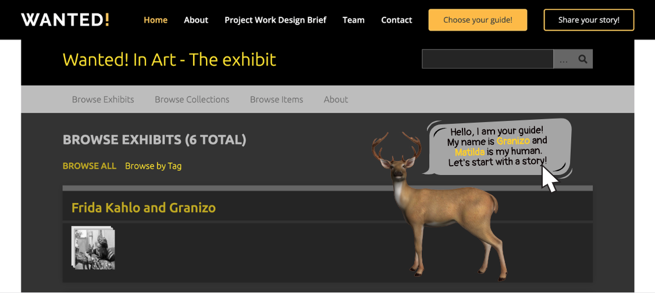
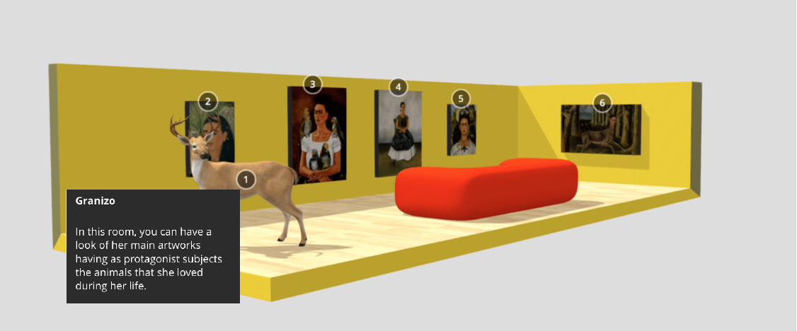
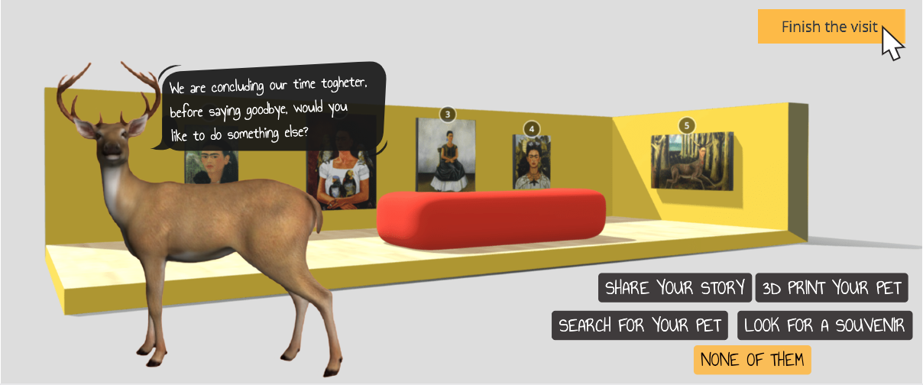
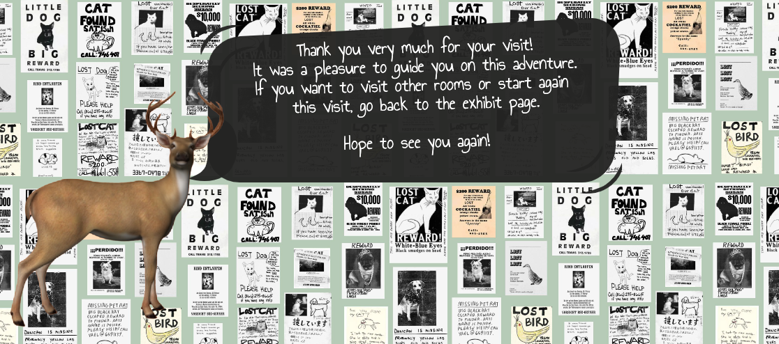
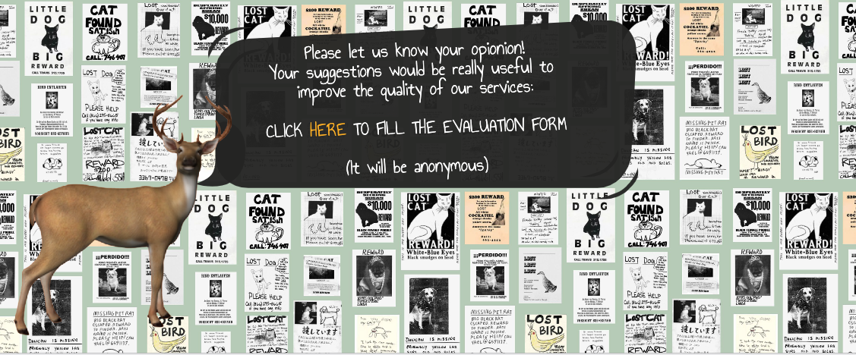
Interactive application
Choose your Guide!
STORYBOARD

Slide 13
Interactive application
Choose your Guide!
STORYBOARD
NON-Interactive computer graphic
3d animation
Format file: *.OBJ
Sw: sketchfab open source resources

Slide 14
Evaluation
Did you like the guide you have chosen?
How useful have been the contents you were told?
How much did you appreciated the final services offered ("Share your story", "3d print your pet", "Search for your pet")?
Overall, how much did yoy like the interactive experience?
Would you recommend this experience to other?
Free comments/suggestions/complains
Likert scale
Extremely
Very
Somewhat
not so
not at all

Slide 15
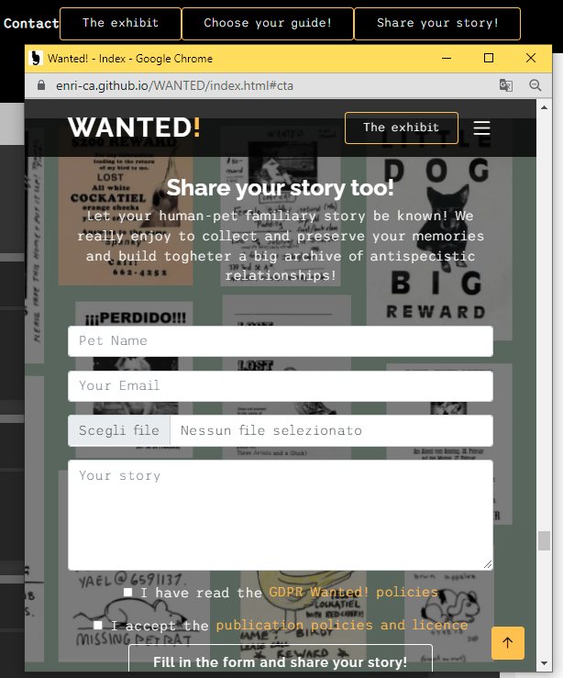
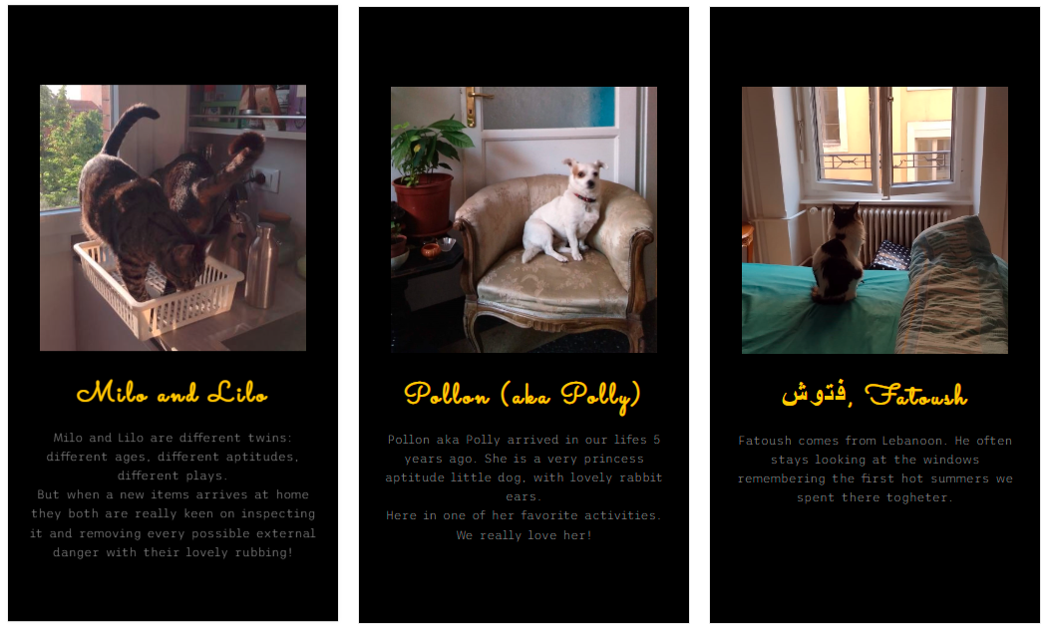
MI-FI PROTOTYPE
Engaging user
Share your story!

Slide 16
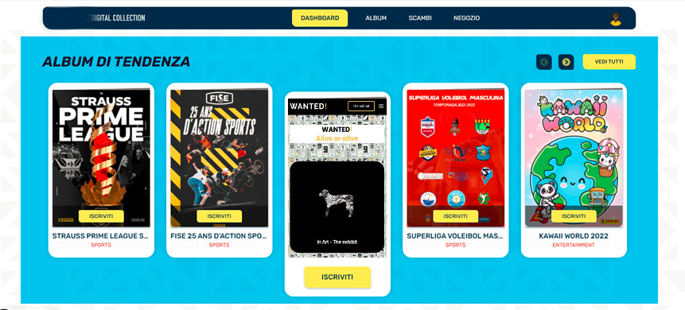
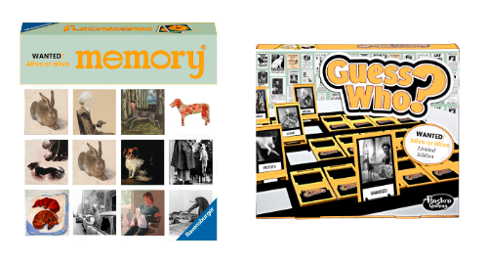
MI-FI PROTOTYPE
Engaging user
Memory and Guess Who? board games (and online versions) Wanted! Edition
traditional board games that have been declined in the years in several versions (Star Wars ed., Disney ed., etc.)
scientific literature shows that board games and their online versions, are useful tool to improve learning ability and social interaction rate
Merchandising
Panini Trading cards and album Wanted! edition
strong Panini Trading cards and Albums tradition
They already offers personalized products from website and applications
Looking for the missing card among other passionated will improve engagement and experience sharing.
Ahmad, Muneeb Imtiaz, et al. ‘A Game-Based Intervention for Improving the Communication Skills of Autistic Children in Pakistan’. Computers Helping People with Special Needs, edited by Klaus Miesenberger et al., vol. 8547, Springer International Publishing, 2014, pp. 513–16. DOI.org (Crossref), https://doi.org/10.1007/978-3-319-08596-8_80.
Notes:
Ahmad, Muneeb Imtiaz, et al. ‘A Game-Based Intervention for Improving the Communication Skills of Autistic Children in Pakistan’. Computers Helping People with Special Needs, edited by Klaus Miesenberger et al., vol. 8547, Springer International Publishing, 2014, pp. 513–16. DOI.org (Crossref), https://doi.org/10.1007/978-3-319-08596-8_80.

Slide 17
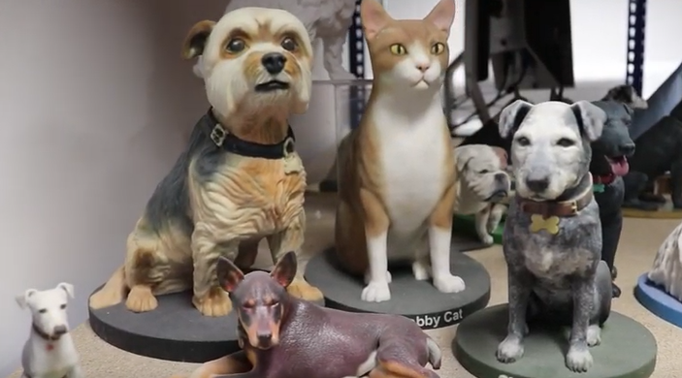
MI-FI PROTOTYPE
Engaging user
Forthcoming applications
3d print your pet
The idea is to develop a tool to realize a 3d printed little modelling of our pet, starting from uploading a 360° video. The merchandising unit will be in charge to realize and send home to the users the realized 3d print that will be used as a gift or a little celebrating statue.

Slide 18
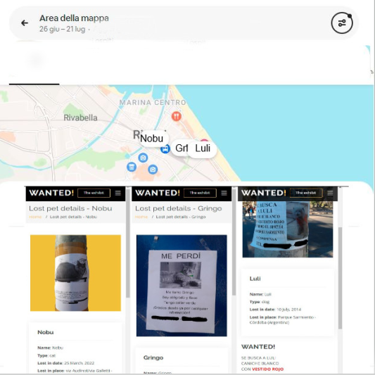
MI-FI PROTOTYPE
Engaging user
Forthcoming applications
Search for your pet!
Search for your pet is a tool able to help people who lost their pets by loading, sharing, and visualizing geolocated data of their missing pets. The user will have the possibility to fill in a form that will structure data similarly to those seen in the Preliminary data section; other users could improve information in case they have seen the lost-pet.

Slide 19
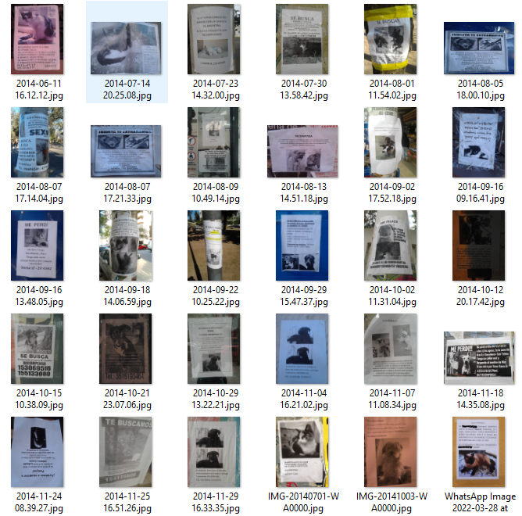
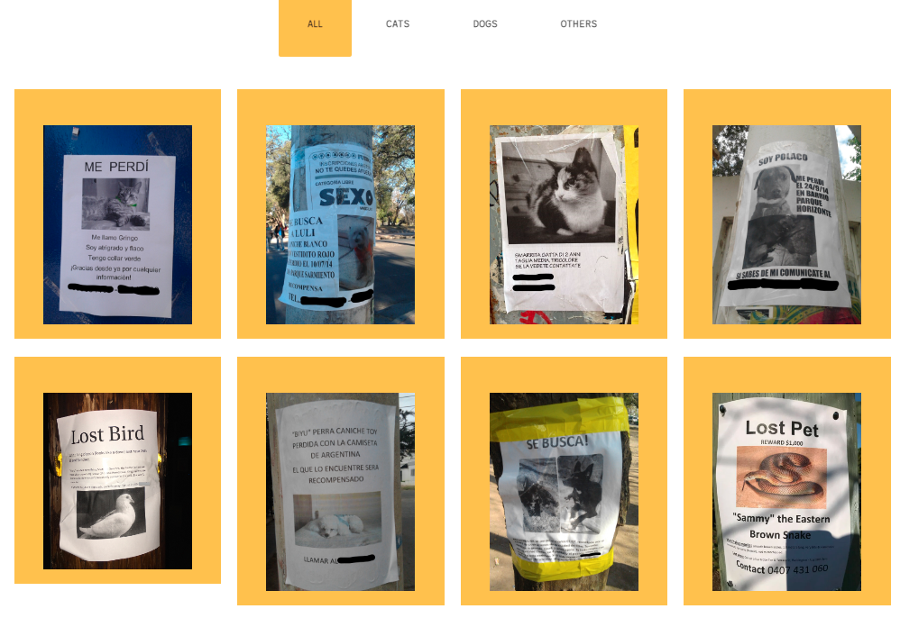
MI-FI PROTOTYPE
Preliminary data
Preliminary data and Inspiration

Slide 20
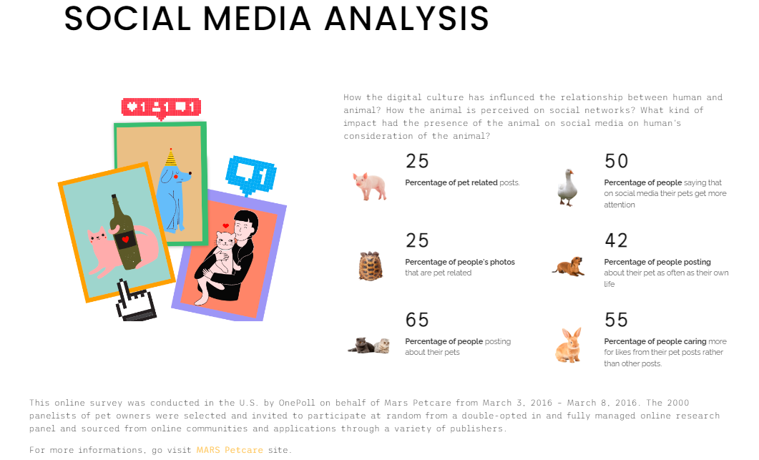
MI-FI PROTOTYPE
Preliminary data and Inspiration

Slide 21
Navigate the website https://enri-ca.github.io/WANTED/
MI-FI PROTOTYPE

Slide 22
How we arrive to define this project?
Ideation process
Preliminary brainstorming and data analysis
Benchmark on reference institutions
Ideation cards and disruptive design
PACT FRAMEWORK
SCENARIOS
Cognitive focus
Museological approach
RECAP
Notes:
ugly duckling

Slide 23
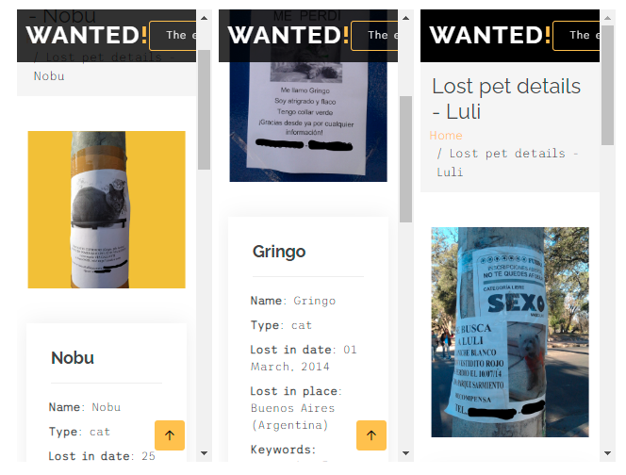
Preliminary data – Textual analysis
RECURRENT PATTERNS:
Often affection diminutives: “caniche” (little dog), “vestidito” (little dress), "patitas"(little paw), "pechitos" (little brest)
talking in first person: “Me perdì” (I got lost);
Human pronouns: “ella” or “she”;
Quite human adjectives: "timido" (shy), "tonto“ (dumb)
humanising of animals, namely the attribution of human's traits, emotions, or intentions to non-human entities.
Notes:
ugly duckling

Slide 24
Preliminary data - Visual analysis
RECURRENT PATTERNS:
Global layout recalling Wanted bandits’ bans>call for action / inverted metaphor
manually added details from the caregiver, such as colouring black-and-white A4 b/w laser-printed copy (“collar verde” or “vestidito rojo” “camiseta de argentina”)
affective tie between the lost animals and their owners
Notes:
ugly duckling

Slide 25
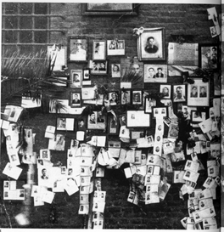
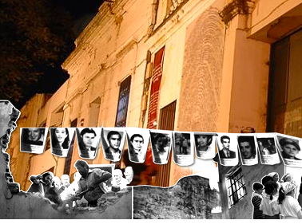
Ref. institution 1: memorial cultural institutions
memorial museums and installations
Museo per la Memoria di Ustica – realized by Christian Boltanski, artist specially devoted to memory and memorial issues
Sacrario partigiani in Piazza Nettuno a Bologna started as a spontaneous initiative of Bologna’s inhabitants
Archivo Provincial de la Memoria/Ex D2, desaparecidos archive in Cordoba Argentina
Devoted to celebrate the intimate memory of missed beloved-ones together with preserve the public testimony of historical facts
Not suitable to celebrate the joyful part of the relationship with the – hopefully momentarily – lost pets.
Notes:
ugly duckling

Slide 26
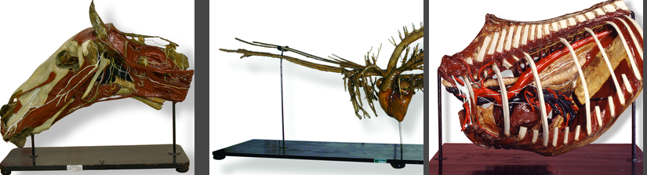
Ref. institution 2: human-pet relation cultural institutions
Pet/animal museums
Collezione di Anatomia degli Animali Domestici dell’Università di Bologna scientific institutions but a little too «medical»…
examples from Simona Caraceni in her Mewselogy course slides (Hermitage cats army guards, Le chat du Louvre, Cat Museum Kotor and Cats Museum Malaysia)
further short and lazy google-search on «cat museum» keywords and use this offered result (over the first 10) «17 Dog and Cat Museums Around the World»
Notes:
ugly duckling

Slide 27
Ref. institution 2: human-pet relation cultural institutions
Broadly analyzing the «17 Dog and Cat Museums Around the World», we find some recurrent caracheristics such as:
Lot of single-pet celebrating institutions
Run by private fundations or individual passionated
Often not technologically updated
Really devoted to passionated and amateurs target
Lack of high museological standards
IN GENERAL:
Lack of an overall institutions exploring the complex emotive human-pet relationship, independently from the reference to a particular species
Try anyway to analyse a physical museum as a possible reference institution (1)
A museum is a non-profit, permanent institution in the service of society and its development, open to the public, which acquires, conserves, researches, communicates and exhibits the tangible and intangible heritage of humanity and its environment for the purposes of education, study and enjoyment.
Notes:
According to the ICOM Statutes, adopted by the 22nd General Assembly in Vienna, Austria, on 24 August 2007, the current definition is as follows
+ icom code

Slide 28
Ref. institution 3: a virtual museum
Idea of creating a virtual cultural environment as reference istitution:
Collecting stories of human-animal affective relationships
Providing cultural contents
Providing cultural contents by talking
stories of «renowned humans» (such as artists)
and their animal affective relationships
and collecting «common visitors» testimony
of similar experiences
Lack of an overall institutions exploring the complex emotive human-pet relationship, independently from the reference to a particular species
analyse the virtual museum as a possible reference institution (2)
Caraceni taxonomy
cathegory E or F
Schweibenz taxonomy:
learning museum
Virtual museum
Beltramini-Gaiani:
virtual with real
Notes:
• the learning museum: a web site offering different points of access for virtual visitors, according to their age, background and knowledge. The information is presented in a context oriented way instead of being object oriented. Moreover, the site is didactically enhanced and linked to additional information that motivates the virtual visitor to learn more about a subject they are interested in and to revisit the site. The goal of the learning museum is to make the virtual visitor come back and establish a personal relationship with the online collection. Ideally, the virtual visitor will come to the museum to see the real objects;
• the virtual museum: the next step on from the learning museum is to provide not only information about the institution’s collection but to link to digital collections of others. In this way, digital collections are created which have no counterparts in the real world. This is the implementation of André Malraux’s vision of the ‘museum without walls’.
(Schweibenz, 2004: 1)

Slide 29
Ref. institution 3: museological approach
E) Virtual museum that enhance museum objects INTERPRETATION with OPEN INTERACTION in an OPEN SPACE showing SELECTED (or ALL OBJECTS) of the museum collection, ALLOWING visitor CONTRIBUTIONS.
F) Virtual museum making EXPERIMENTS with NEW MUSEOLOGICAL MODELs with OPEN INTERACTION in an OPEN SPACE showing SELECTED (or ALL OBJECTS) of the museum collection, ALLOWING visitor CONTRIBUTIONS.
Caraceni taxonomy, E (and for certain aspects
also F) category:
community of people sharing the same interest in the collection,
objects and information on display in the museum
the community is linked by a strong personal interest in the
heritage on display
* participation of visitors in building the collection
*virtual museum of ‘living’ memories of people
NEED Interpretation - Experimentation/complex museum identity
INTERACTION Open
SPACE Open
CONTENT Selected works - Photograph, texts, geo-referenced material
VIRTUAL/REAL Virtual with real*/Virtual with virtual
VISITORS CONTRIBUTIONS Allowed
Gaiani-Beltramini:
4. Virtual with real: in this category the researchers have identified a type of virtual museum that they define as a digital space built with the use of technology. This virtual space can shape a real space or an ideal space shaped for virtual exhibition. What identifies the virtual museum is that the objects
shown are real objects that have been digitalised for display in a virtual space to be better studied or browsed.
Notes:
Caraceni, Simona. Designing a Taxonomy for Virtual Museums for the Use of Avicom Professionals. ProQuest Dissertations Publishing, 2015. https://search.proquest.com/docview/1985629546?pq-origsite=primo.

Slide 30
Physical museum 0 – Intro
The Cat Cabinet was founded in commemoration of the ginger cat John Pierpont Morgan (1966-1983). This special cat was the stubborn, headstrong companion of the museum's founder, Bob Meijer.
The museum is housed in the impressive, classically-furnished first floor - or piano nobile - which contains five rooms and is itself an attraction.
We choose as example the KattenKabinet (Cat Cabinet)
https://www.kattenkabinet.nl/
https://www.facebook.com/CatCabinet/
https://www.instagram.com/het.kattenkabinet/
Herengracht 497, 1017 BT Amsterdam The Netherlands
Tuesday to Sunday from 12:00-17:00
Context
The collection of the Cat Cabinet offers a wide look at the role of the cat in art and in culture through the centuries.
Neighborhood: Centrum
Amsterdam’s buzzing hub, with its sprawling network of tram rails and a seemingly constant flow of tourists and commuters, yields convenient access to some of the best sightseeing, shopping, and street life in Europe. Closest at hand are the Royal Palace, the quaint shops of Haalremmerdijk, the pedestrianized zones Kalverstraat and Dam Square with popular neighborhoods such as the Red Light District, and the Canal Ring hardly more than a moment’s stroll away. With the well-connected Centraal Station as Centrum’s base, it's easy to travel farther afield via one of the city’s iconic trams. (from https://www.tripadvisor.com/Attraction_Review-g188590-d196104-Reviews-The_Cat_Cabinet-Amsterdam_North_Holland_Province.html)
Notes:
ugly duckling

Slide 31
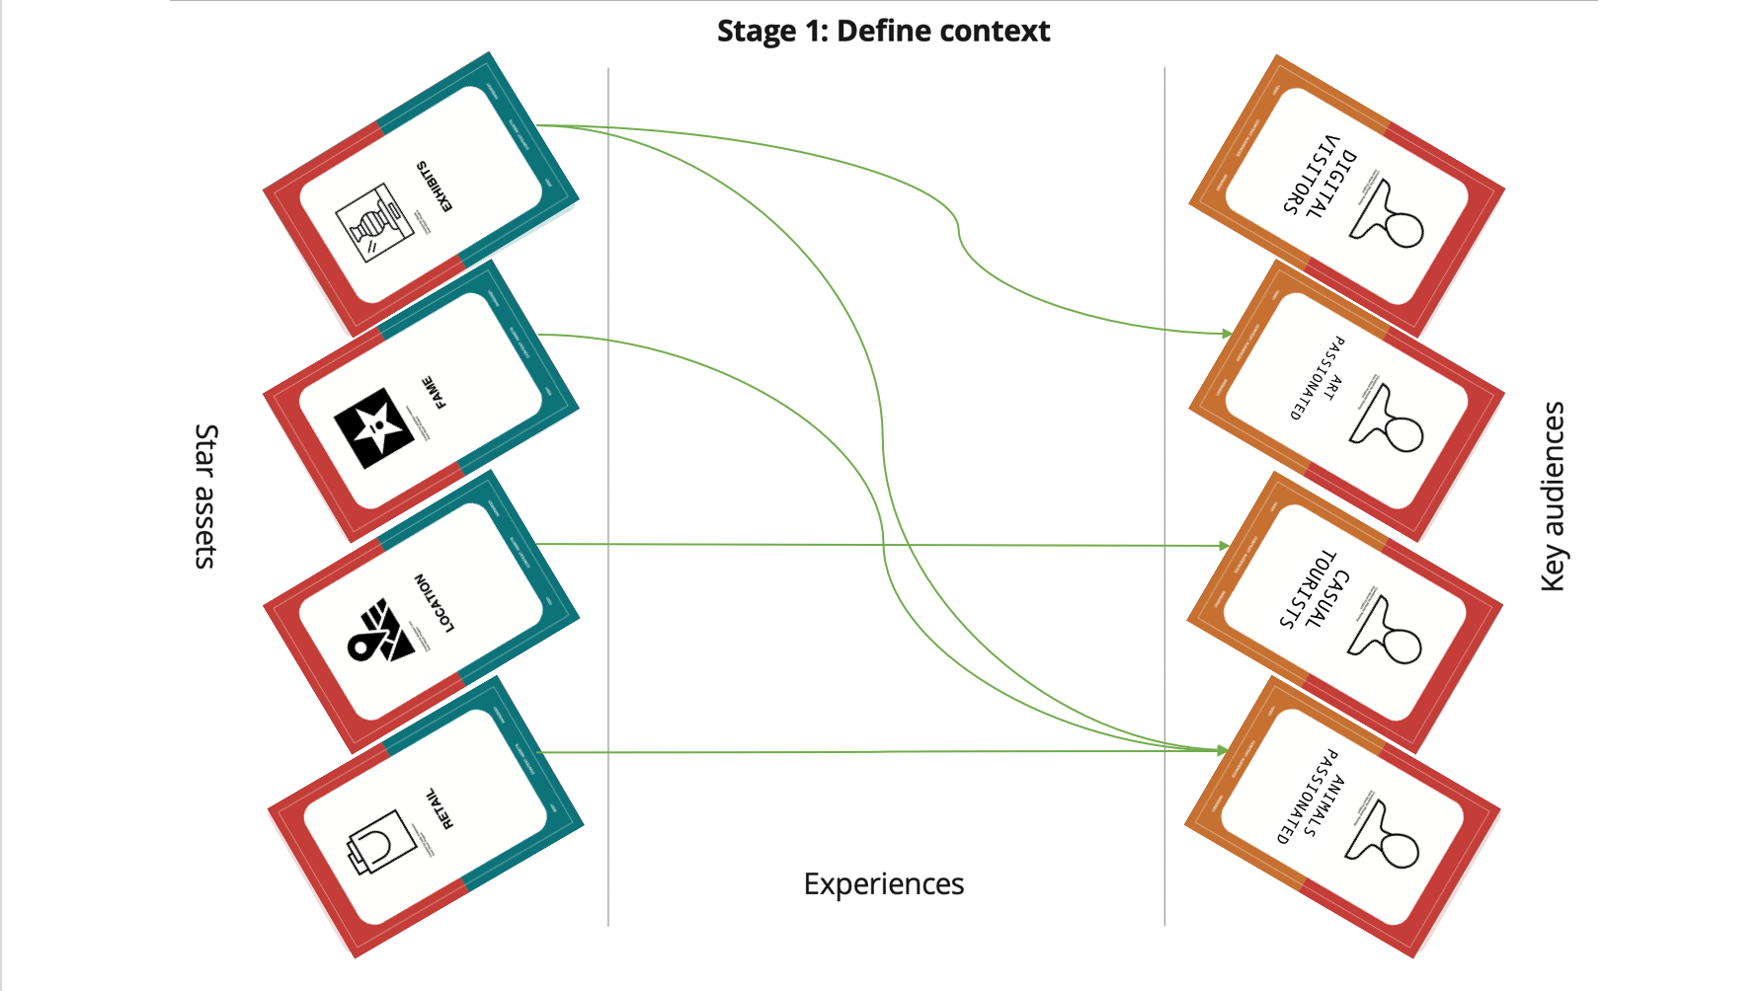
Physical museum – KattenKabinet 1 – Define context
Star Assets
retail
location
fame
exhibits*
early Virtual tour in flash
Key Audience
Animal passionate*
Casual tourist
Art passionate*
Digital visitors*
Notes:
Busy-selective-greedy
Transient-sampler-methodical (Serrel)
Rush-stroll-study (Dean) Casual-Cursory-Learner

Slide 32
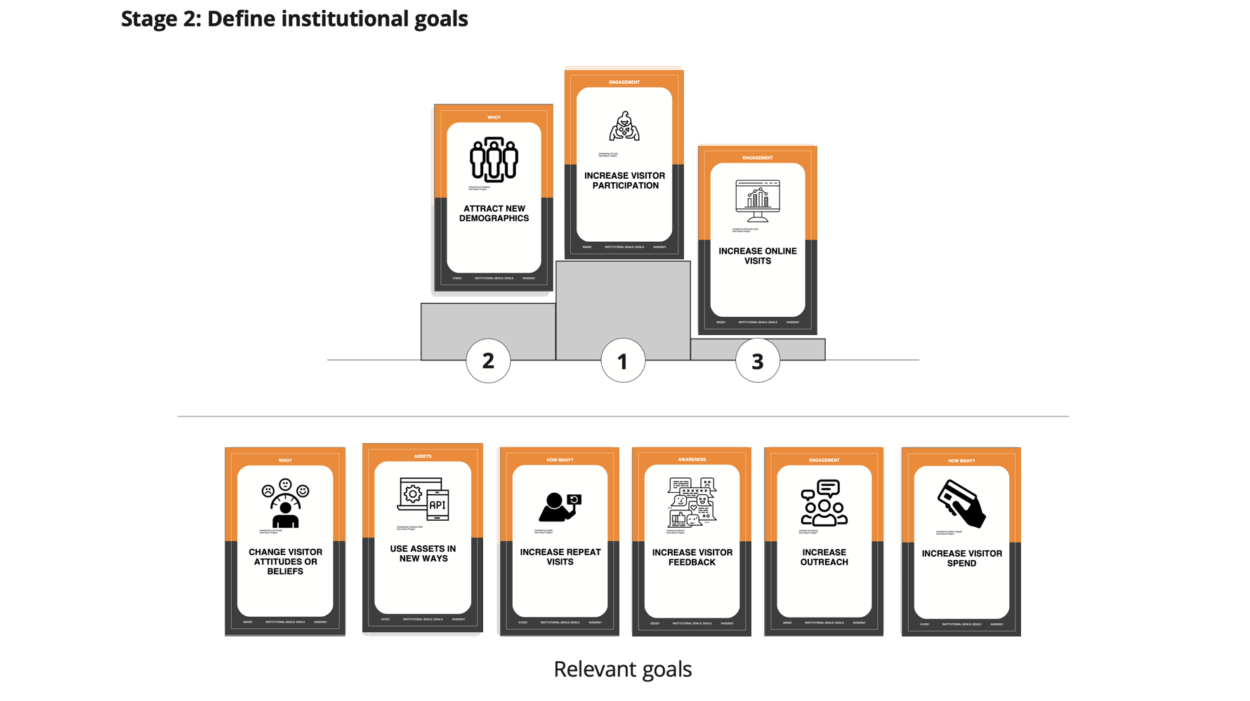
Physical museum – KattenKabinet 2 – Define Institutional goals
1. Increase visitor participation
2. Attract new demographics*
3. Increase online visits*
Change visitor attitudes and beliefs*
Use assets in new ways*
Increase repeat visits
Increase visitor feedback
Increase outreach*
Increase visitor spend
Notes:
ugly duckling

Slide 33
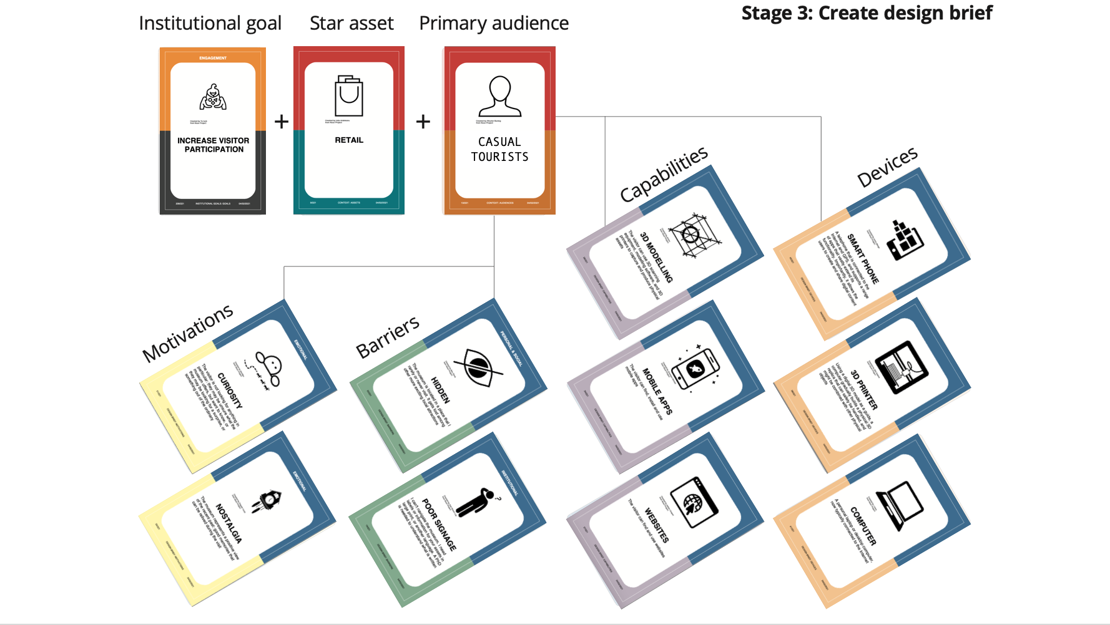
Physical museum – KattenKabinet 3 – Create design brief
GOAL increasing the visitor participation
ASSET retail
AUDIENCE Casual tourist
MOTIVATIONS curiosity, nostalgia
BARRIERS hidden, poor signage
DEVICES smart phones, computer, 3d printer
CAPABILITIES 3d modelling, mobile apps, websites
Notes:
ugly duckling

Slide 34
Physical museum – KattenKabinet 3 – IA design brief «3d print your pet application»
The final design brief for the physical institution designed the 3d print your pet application with the following characteristics:
devoted to the goal of increasing the visitor participation, oriented to the target audience of casual tourist through the retail asset.
In particular, we devised the possibility to engage the casual tourists, that who could encounter barriers due to the low visibility (hidden) of the museum or the unavailable mobile connection poor signage, via the smart phones devices they are provided of during the travel or via computers they have at home before the visit; the museum could offer in site or off-site a 3d printer service to 3d print a model of their pet.
Motivations to visit the place or use the service include curiosity and nostalgia;
capabilities required or assumed are the familiar use of mobile apps and websites while the 3d modelling is previewed as to be improved.
GOAL increasing the visitor participation
ASSET retail
AUDIENCE Casual tourist
MOTIVATIONS curiosity, nostalgia
BARRIERS hidden, poor signage
DEVICES smart phones, computer, 3d printer
CAPABILITIES 3d modelling, mobile apps, websites
Notes:
ugly duckling

Slide 35
Disrupt design with PACT framework
AFTER OUR ANALYSIS WE CAME TO TE CONCLUSION THAT SOME ASPECTS OF OUR DESIGN WEREN’T TAKING INTO ACCOUNT THE REALITY.
P
A
C
T
THE TARGET PEOPLE CHOOSED FOR THIS DESIGN WAS RESTRICTED AND DIFFICULT TO BE INVOLVED IN THE ACTIVITY
IN A SO SPECIFIC LOCATION THE ACTIVITIES PROPOSED TO AN EVEN SPECIFIC AUDIENCE WERE NOT SO ATTRACTIVE
THE CONTEXT (MUSEUMS) MAYBE COULD NOTHAVE THE RESOUCE TO AFFORD THE IMPLEMENTATION AND ASSIST THE VISITORS
THE TECHNOLOGIES THAT COULD HAVE BEEN INVOLVED WERE TOO AMBITIOUS FOR A SMALL MUSEUM

Slide 36
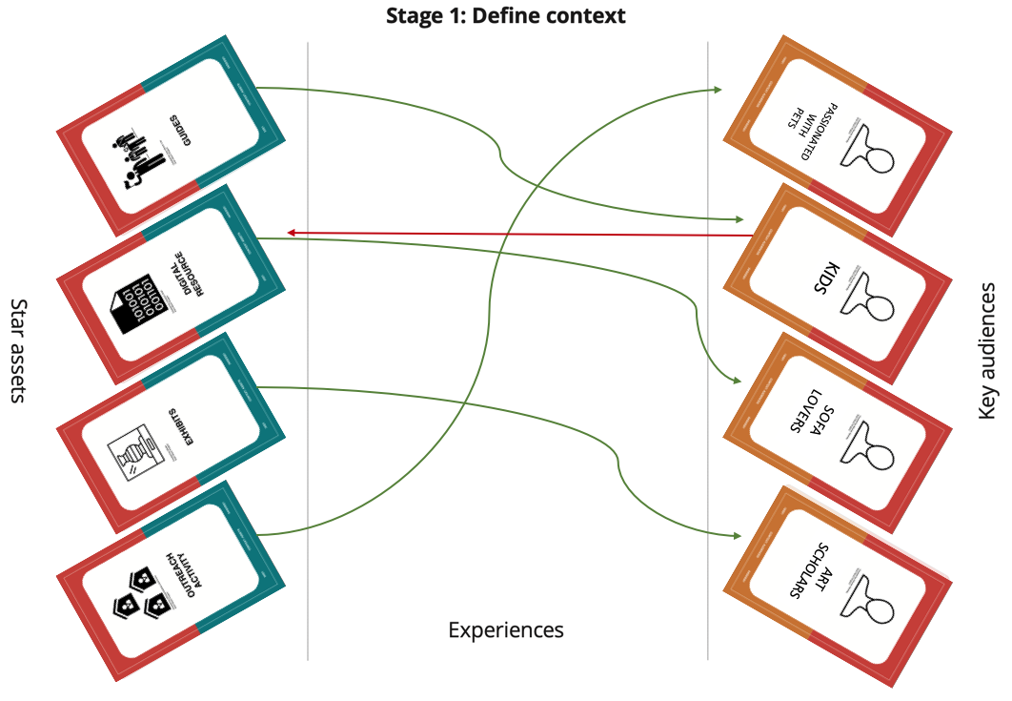
Virtual Exhibition 1 – Define context
Star Assets
Guides
Digital resources
Outreacht activities
exhibits*
Key Audience
Sofa lovers*
Art students/scholars*
kids
passionate with pets*
Notes:
ugly duckling

Slide 37
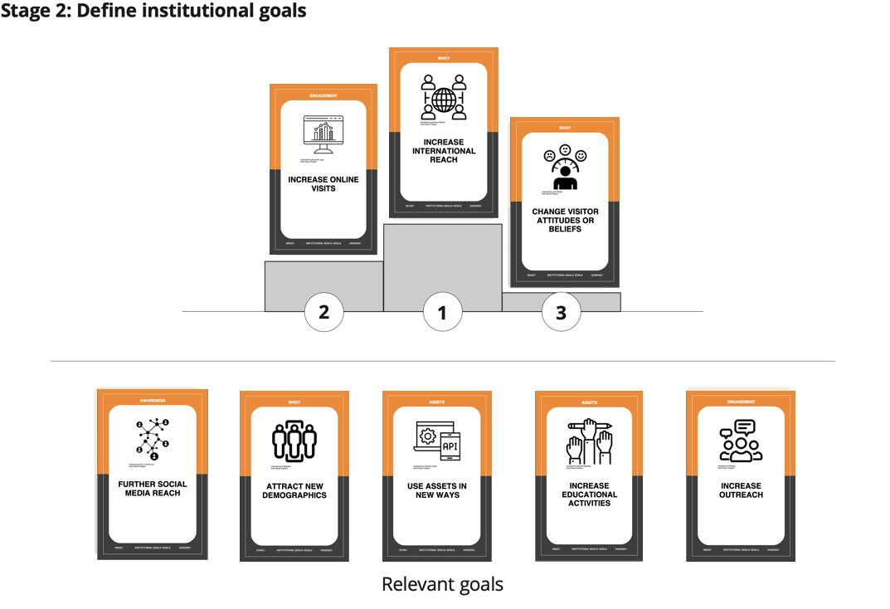
Virtual Exhibition 2 – Define Institutional goals
1. Increase international reach
2. Increase online visits*
3. Change visitor attitudes and beliefs*
Further social media reach
Attract new demographics*
Use assets in new ways*
Increase educational activities
Increase outreach*
Notes:
ugly duckling

Slide 38
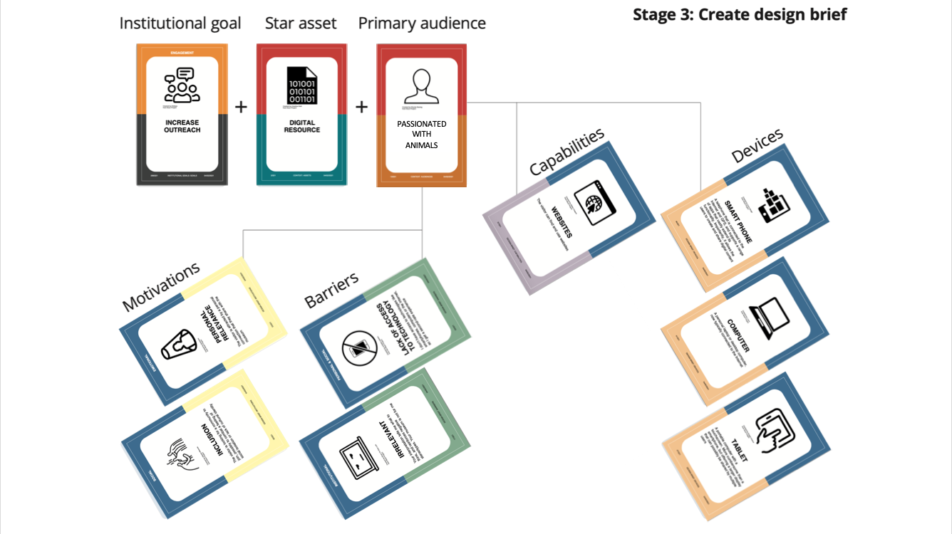
Virtual Exhibition 3 – Create design brief
GOAL Increase outreach
ASSET digital resource
AUDIENCE passionated with animals
MOTIVATIONS personal relevance, inclusion
BARRIERS irrelevant, lack of access to technology
DEVICES smart phones, computer, tablet
CAPABILITIES websites
Notes:
ugly duckling

Slide 39
Virtual Exhibition 3 – IA design brief «Choose your guide app»
The final experience designed for the virtual museum, is the Choose your guide application that allows to have a guided visit of the virtual museum, accompanied by a personalized guide, chosen in relation with the user's preferences. At the end of the visit, a space of interaction with the users is provided, giving to them the possibility to choose further related activities.
The main goal is to increase the outreach on high level quality educational digital contents (digital resources asset) of a larger audience (passionate with animals target audience) than only art passionate.
Barriers for the new users could be mainly represented by irrelevance of cultural content for them and secondarily by lack of access to technology that is solved with a really basic access level requested, such as the minimal knowledge and use of websites via computer, mobile phones or tablets (capabilities and devices).
Motivations to use the application and visit the exhibition are personal relevance of the topic (human/artist-animal affective relationship) and the informal/funny way in witch the same is proposed (animals talking, social media adv, etc.) that, together with the other activities proposed (Share your story, Search for your pet, merchandising, etc.), improve the users' sensation of inclusion.
GOAL Increase outreach
ASSET digital resource
AUDIENCE passionated with animals
MOTIVATIONS personal relevance, inclusion
BARRIERS irrelevant, lack of access to technology
DEVICES smart phones, computer, tablet
CAPABILITIES websites
Notes:
ugly duckling

Slide 40
Museological approach
The cultural environment can be classified in the E or F category, according to Simona Caraceni taxonomy:
E) Virtual museum that enhance museum objects INTERPRETATION with OPEN INTERACTION in an OPEN SPACE showing SELECTED (or ALL OBJECTS) of the museum collection, ALLOWING visitor CONTRIBUTIONS.
F) Virtual museum making EXPERIMENTS with NEW MUSEOLOGICAL MODELs with OPEN INTERACTION in an OPEN SPACE showing SELECTED (or ALL OBJECTS) of the museum collection, ALLOWING visitor CONTRIBUTIONS.
NEED Interpretation - Experimentation/complex museum identity
INTERACTION Open
SPACE Open
CONTENT Selected works - Photograph, texts, geo-referenced material
VIRTUAL/REAL Virtual with real/Virtual with virtual
VISITORS CONTRIBUTIONS Allowed
Notes:
Caraceni, Simona. Designing a Taxonomy for Virtual Museums for the Use of Avicom Professionals. ProQuest Dissertations Publishing, 2015. https://search.proquest.com/docview/1985629546?pq-origsite=primo.

Slide 41
IA classification
http://www.v-must.net/virtual-museums/categories
Hornecker, Eva, and Luigina Ciolfi. Human-Computer Interactions in Museums. Springer Nature, 2022.
To classify the Interactive application proposed - Choose your guide - we used the V-MUST (1-8) and Hornecker-Ciolfi (9.1-9.3) classifications:
1. By Content human-pet affective relationship
2. By Interaction technology device-based, speech-based
3. By Duration basically short; depending on the user's choices
4. By Communication narrative, dramatization
5. By Level of immersion medium
6. By Format desktop and mobile, on line
7. By Scope education, engagement
8. By Sustainability to be analysed
9. By Interaction frame
9.1 Relationship to the Museum Environment-Space and Visitor Mobility: mobile interaction
9.2 Relation to the form of augumentation and experience: extended Reality: VR, fully artificial
9.3 Interaction beyond the physical visit post-visit: engaging the visitor; pre-visit: preparing visit
Notes:
V-MusT.net is a Network of Excellence, funded by the European FP7 Network of Excellence (Grant Agreement 270404), focused on Virtual Museums. It aims to provide the heritage sector with the tools and support to develop Virtual Museums that are educational, enjoyable, long-lasting and easy to maintain. V-MUST.NET, coordinated by CNR, is participated by 18 partners, coming from 13 different Countries and more than 100 Associated Members. The project is developed in 4 years (1st of February 2011 - 31st of January 2015).
http://www.v-must.net/virtual-museums/categories
Hornecker, Eva, and Luigina Ciolfi. Human-Computer Interactions in Museums. Springer Nature, 2022.

Slide 42
PACT
It seemed to be useful, at this point, to proceed on the logical base of the PACT analysis together with the design cards.
And we started from people.
PEOPLE doing ACTIVITIES in a CONTEXT using TECHNOLOGY

Slide 43
PACT People
TOOLS
Observations
Analysis of social behaviours
THE MATERIAL COLLECTED BY ENRICA SINCE 2014 (LOST PETS ADVICES)
PERCEPTION OF THE ANIMAL ON SOCIAL MEDIA (PET INFLUENCERS)
THE NEED FOR A PLATFORM WHERE TO PUBLISH AN ANNOUNCEMENT OF LOST PET

Slide 44
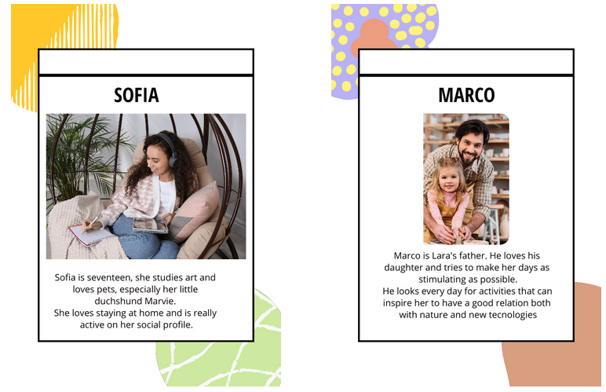
PACT People: Personas
PEOPLE doing ACTIVITIES in a CONTEXT using TECHNOLOGY
Personas (Alan Cooper, 1999)
Concrete representation of target users - based on real data collected: different type of people the I.A. is designed for
They have a name, background, goals and aspirations
ENGAGING PERSONAS: vivid description in involving stories, mix of
GOAL-DIRECTED: workflow, what my P wants to do with my I.A. to achieve their GOALS?
ROLE-BASED: behaviour/role, how my P will use my I.A.?

Slide 45
PACT Activities
PEOPLE doing ACTIVITIES in a CONTEXT using TECHNOLOGY
SCOPE AND GOALS: what need/problem?
TIME: how long? Occasional/regoular? Calm or busy moment?
COOPERATION: alone/togheter?
COMPLEXITY: simple/well guided?
SECURITY: has potential impact?
CONTENT: what kind of data imput/output? What media?
MARCO AND LARA:
An entertainment for a bored kid
Occasional, in a calm moment
An activity that can be done alone
but also in more than one person
Well guided
It doesn’t require sensitive data
In some parts the user can share
personal experiences making use of
any kind of media (text, video, images…)

Slide 46
PACT Context
PEOPLE doing ACTIVITIES in a CONTEXT using TECHNOLOGY
PHYSICAL SPACE: how is it?
SOCIAL: alone/groups, backgrounds
ORGANISATIONAL: how the work environment, roles, management?
Anywhere, preferably in a quiet environment
Alone

Slide 47
PACT Technologies
PEOPLE doing ACTIVITIES in a CONTEXT using TECHNOLOGY
Which
MEDIA
DIGITAL CONTENTS (and how to acquire them)
HW-SW
ONLINE/OFFLINE/ONSITE
INTERACTIVE/NO
IMMERSIVE/NO
DEVICES
VISUAL/AUDIO?
Texts, Images, 3D modelling
Blender, Twine, Zephyr,
Online
Interactive
Immersive
A computer, a tablet, a smartphone
Visual

Slide 48
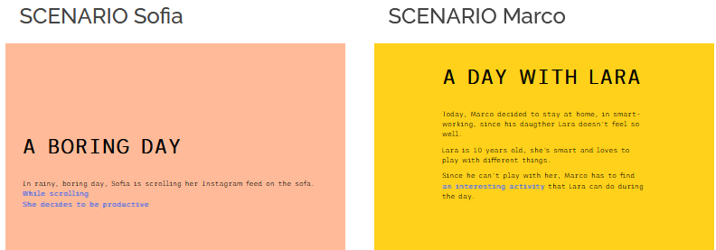
Scenarios
SCENARIOS: STORIES about PEOPLE doing ACTIVITIES in a CONTEXT using TECHNOLOGY
STORIES: taken from real life
CONCRETE SCENARIO: generalization with details of design
CONTEXT SCENARIO: how the application can best serve the needs of the persona
KEY PATH SCENARIO: how a persona uses/interacts with the application to achieve their goal/s

Slide 49
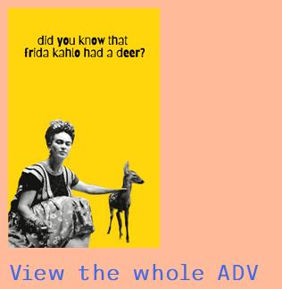
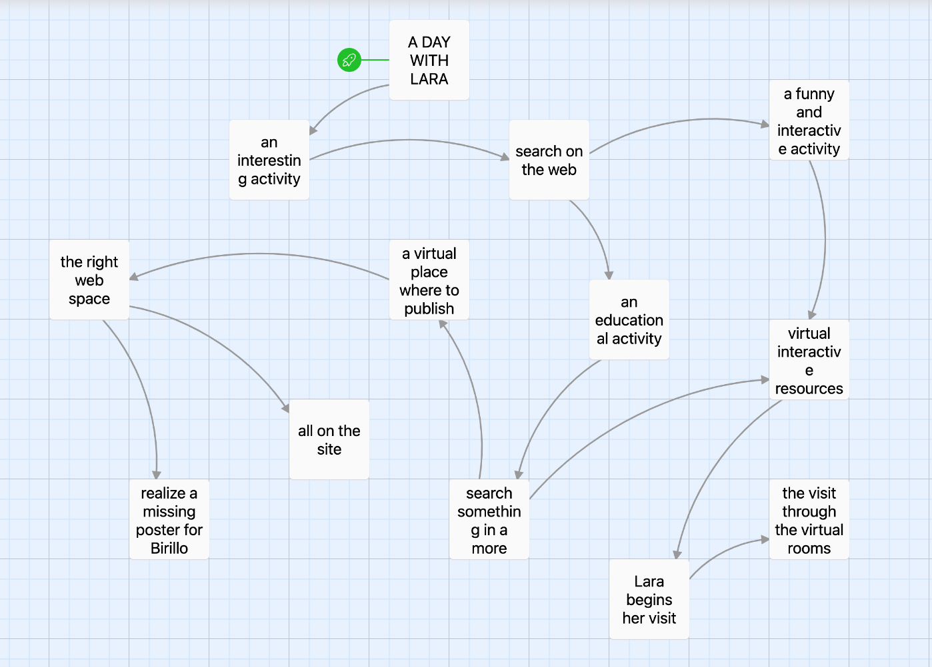
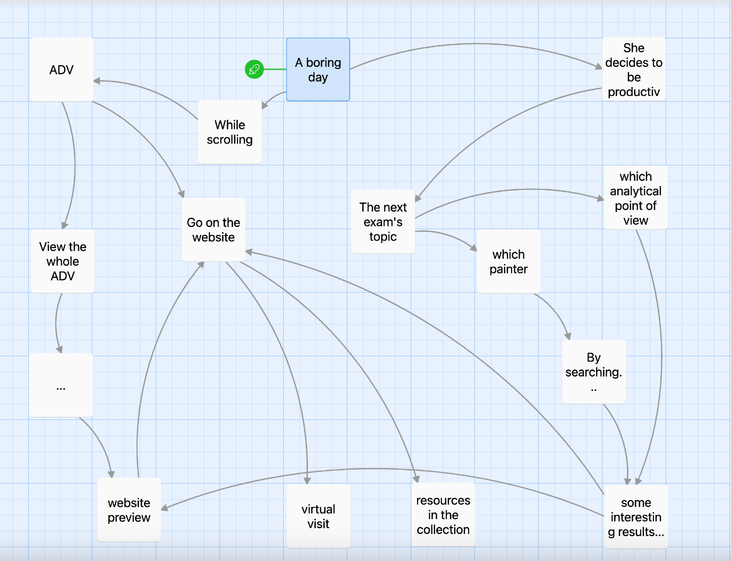
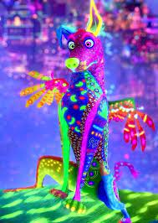
WHAT IF..?
INVOLVEMENT OF TWINE
DUE TO THE TOOLS IT OFFERS, WE FOUND TWINE A VERY POWERFUL WAY TO EXPRESS DIFFERENT POSSIBILITIES FOR OUR SCENARIOS IN A NARRATIVE BACKGROUND.
MARCO
SOFIA

Slide 50
Cognitive focus
WHICH COGNITIVE ASPECT OUR DESIGN TAKES INTO ACCOUNT?
EMPATHY
LANGUAGE and narrative
MEANINGFULNESS-EMOTIONS
VISION
MEMORY AND RECALL

Slide 51
Cognitive focus chosen
Memory-Recall
«Results show that allowing players to navigate freely through the game has positive effects on cognitive interest and a feeling of presence. An implicitly structured game leads to increased recall of spatial information. However, for optimal learning of factual knowledge, guidance is beneficial.”
Ferguson, Chris, et al. ‘On the Role of Interaction Mode and Story Structure in Virtual Reality Serious Games’. Computers & Education, vol. 143, Jan. 2020, p. 103671. DOI.org (Crossref), https://doi.org/10.1016/j.compedu.2019.103671.
Meaningfulness-Emotions-Empathy

Slide 52
Goals
Cognitive: increase visitor participation via engagement through the personalized guide and beyond the visit services (educational merchandising, “Share your story”, future “Search for your pet”, etc.)
Cultural and educational: attract new demographics to art history
Economic: increase online visits and connected revenues (Instagram posts, partnertship and sponsorships, etc.)

Slide 53
Requirements and foreseen workflow
The actual realization of the pilot version of Virtual Exhibition, the 3d room and the related applications, have been possible using the following software and tools: 1. Github: website repository 2. Omeka.net (free trial version): Virtual Exhibition 3. Blender: 3d room 4. Twine: interaction diagrams 5. Zephir 3d (14 days free Lite version trial): 3d print your pet (not realised application)
The future complete realization of the project will surely require a multidisciplinary team with professionals covering all issues related to contents or technical aspects. Here are listed just the main:
1. Scientific committee composed by Art historians, Ethologists, Anthropologists etc.: to curate the scientific aspects of the exhibition and the related documentation 2. Art curator/gallerist/copyright lawyer: to face the copyright issues and possible request of reproduction 3. Pedagogist: to balance the contents and the language used according to the different target of the fruition paths (classical Virtual Exhibition or the 3d rooms or interactive applications) 4. Software developers in charge of the back-end 5. Communication team and Social media manager: to curate the website and the social media and reach new public and realise marketing strategies 6. User experience experts and a 3d modellers: to realize 3d guides and 3d artists’ rooms 7. Statisticians or sociologists to evaluate users’ feedbacks and impact.

Slide 54
Further development and maintenance issues
Further developments of the project include the forthcoming release of new tools and merchandising conceived to improve the user’s interaction and engagement as well as to assure the project sustainability (some of our proposals are illustrated in the Forthcoming section)
To achieve these goals, the creation of a network of partnerships and/or sponsorships with economic and cultural related realities will be welcomed.
These relationship will also increase the project visibility and the possibility to have social media advertising revenues - an example have been shown in the Sofia scenario.

Slide 55
Envisionment techniques used
Conceptual maps
Scenarios
Storyboard
Navigation maps
Prototype (medium fidelity): concrete but partial representation or implementation of a system design

Slide 56
TO RECAP 10 golden rules
1. Maintenance: designed for target audience, context, time:
low level of new technologies adapted for low access level and low maintenance;
updating > forthcoming;
re-using: museological path; private merchandising partnership for economic sustainability
accessibility: text-to speech
2. Integration: with people, place, context of museum
3. Co-design: Personas
4. Content: VALID, RELIABLE, TRACEABLE, TRANSPARENT digital assets
Research sources, documentation (p. 3-4 London Charter)
Historic rigorous, scientific transparency (p. 5-6 Sevilla Principles)
5. PoNR: 29/06/2022!

Slide 57
10 golden rules
6. GAP: between users-technologies-CH contents
Filled by using Guide archetype
7. ENGAGEMENT: to attract attention, increase reflection, stitimulate new toughts
Use of personal/familiar/popular
Playful dynamics
8. GENESIS:
GOAL: increase outreach
TARGET: animals’ lovers
9. DURATION: short to allow connection with collection and contents, but longer if using further activities
10. DISSEMINATION:
Dissemination plan: by IG and social
Evaluation plan: users will be asked to assess the Interactive Application
Notes:
Dante: è un cane nudo messicano, amico di Miguel. Nella terra dei vivi sembra un semplice cane, mentre nel mondo dei morti si rivela un alebrije, cioè una guida spirituale, poiché ha guidato Miguel da Héctor e lo ha accompagnato per tutto il suo viaggio.
Pepita: è lo spirito guida di Mamá Imelda. Ha l'aspetto di un enorme giaguaro con corna di ariete, ali e zampe posteriori d'aquila e la coda striata simile a quella di un'iguana. Dopo aver salvato Miguel, sconfiggerà Ernesto de la Cruz scagliandolo contro una campana che lo schiaccerà. Nella terra dei vivi, che raggiunge insieme a Dante e ai parenti di Miguel, assume le sembianze di una gatta.
https://it.wikipedia.org/wiki/Coco_(film_2017)

Slide 58
Thank you for your attention!

